Slide 1
Trusted Execution Environment Provisioning (TEEP) WG
Dave Thaler
Hannes Tschofenig
Mingliang Pei

Slide 2
History
TEE hardware is available for a long time (e.g. TEEs in mobile phones).
It took a long time for the hardware security features to be used widely. In the meanwhile, it is also used in the mobile phone world – not necessarily in other industry sectors (e.g. IoT).
Trusted App development and distribution are hard
Much harder today than that for normal apps via an App Store
Trust and management issues due to multiple parties involved in the scenario
The IETF created a working group to standardize a protocol to supported provisioning of code and configuration data into a TEE.
Initial contribution was the Open Trust Protocol (OTrP) [OTRP].

Slide 3
Requirements
Device/TEE admin wants to manage what TAs are allowed in its TEE (e.g., because of limited secure storage capacity)
Device/TEE admin wants to keep a given TA and/or its config encrypted (independent of anything the author does) so needs to be in the loop when the TA is installed
Trusted Application author wants to keep the TA code and/or its configuration encrypted (independent of anything the device/TEE admin does) and only let it be decryptable within a kind of TEE that it trusts to keep the info private, so needs to somehow be in the loop when the TA is installed
TEE chip vendor wants to only allow authorized TAs to run in its chip, e.g., first vet the code as being safe under the assumptions that TEE chip makes
Device manufacturer wants to only allow authorized TAs to run in the TEE on its devices, e.g., first vet the code as being safe under the assumptions that TEE chip makes

Slide 4
Need of a TEEP Protocol and its Applicability
The requirements call for a new protocol for TA management
For simple case that a TEE just loads and verifies a signed TA from an untrusted filesystem without those TA management requirements, the classic application protocol can work
The TEEP protocol provides a TA management solution for TEEs that can install and enumerate TAs in a TEE-secured location where another domain-specific protocol standard (e.g., [GSMA], [OTRP]) that meets the needs is not already in use.

Slide 5
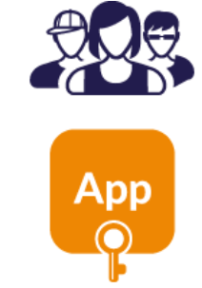
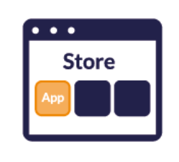
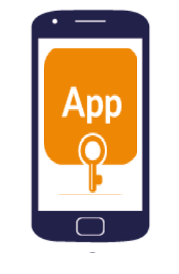





Entity Roles and Example Experience
App Developer
App developer uploads their Normal App to a suitable app store. Trusted App could be optionally bundled inside the Normal App
End user downloads Normal App from an app store. Normal App, or its installer, triggers Trusted App install.
End User
End user enjoys a rich experience and the security of a TEE backed trusted component
2a
OR
App developer builds two components:
Normal App
Trusted App
App developer sends their trusted app to a TAM provider
2b
Normal App, or its installer, communicates to TAM, and installs Trusted App into the TEE
Trusted App Manager
(TAM)
Notes:
Who runs the TAM? The end device admin?

Slide 6
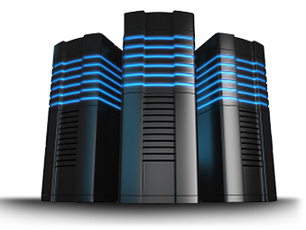

Questions the TEEP architecture addresses
Developer
Device with TEE
TAM
TA
Normal World
Secure World
TA
Applications
TA
TA
Rich OS
TEE
Device owner:
What developers do I trust?
What TAs to accept?
Manufacturer:
How to trust over-the-air updates?
Developer:
How to update my trusted apps on many devices with different TEEs?
What devices to trust?
How to identify a remote device?
TEE Provider:
How to verify and allow installation of many apps from different developers?
Hardware Platform

Slide 7
Protocol Roles
TAM
Device
TEEP TAM
TEEP Agent
TEEP session
API calls
API calls
Transport server
TEEP Broker
Transport session
REE
TEE

Slide 8
Trust Anchors
Trust Anchor definition largely follows that in RFC5280 and RFC6024
A trust anchor represents an authoritative entity via a public key and associated data.
The trust anchor data format is left as implementation specific.
The Trust Anchor Store in a TEE contains a list of Trust Anchors
Raw public keys or certificates
The certificate validation relies on Trust Anchors, stored in TEEP Agent and TAM respectively.
More about the involved keys on the next slide…

Slide 9
Keys
Purpose | Cardinality & Location of Private Key | Private Key Signs | Location of Trust Anchor Store
Authenticating TEEP Agent | 1 per TEE | TEEP responses | TAM
Authenticating TAM | 1 per TAM | TEEP requests | TEEP Agent
Code Signing | 1 per Trusted Component Signer | Trusted Component binary | TEE

Slide 10
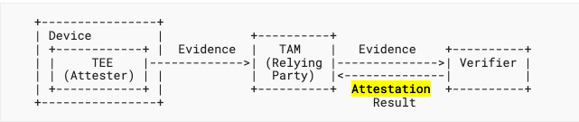
TEEP Attestation
Attestation is the process for a device to prove to a TAM that
a TEE in the device has particular properties, or
was built by a particular manufacturer, and/or
is executing a particular TA, or
other claims

Slide 11
Attestation Data Format
Different devices, manufacturers, and TEEs support different attestation protocols.
TEEP protocol is designed to be agnostic to the format of evidence and attestation results
allow proprietary or standardized formats to be used between a TEE and a verifier.
Verifier may or may not be co-located with the TAM.
Attestation agility
TEEP is designed to allow a device to inform a TAM the attestation technology it uses.
A device may support only one attestation technique while a TAM likely needs to support more than one attestation techniques.
Requirements on a format to be supported
A format MUST support encryption of any information that is considered sensitive
Converge on the incoming standards by IETF RATS WG work
TEEP protocol specifies the TEEP required information in attestation results for TAM to consume if the device attestation uses an “Entity Attestation Token (EAT)” defined by the RATS WG.

Slide 12
Notional Architecture of TEEP
Trusted Component Signer
Device
Device
Administrator
App-1
TA
TEE-1
Policy
Trusted Component 1
Trusted Component 2
App-2
TAM-1
TEEP Agent
TEEP Broker
TAM-2

Slide 13
Protocol Layers
Broker Model:
A
B
C
TEE
TEE
TEE
TEEP Agent
TEEP
TAM
Agent
TEEP/HTTP Client
TEEP-over-HTTP
TEEP/HTTP Server
(other direction also possible
but not yet specified in a spec)
HTTP(S) Client
HTTP/TLS
HTTP(S) Server
Broker
REE
REE
REE

Slide 14
TEEP Transport
TEEP Agent
HTTP(S) Client
(broker)
HTTP(S) Server
TEEP TAM
HTTP POST tam-uri, Accept: application/teep+cbor
(empty)
200 OK, Content-type: application/teep+cbor
QueryRequest(tam-cert)
Verify TAM
HTTP POST tam-uri, Content-type: application/teep+cbor, Accept: application/teep+cbor
QueryResponse(“I need TA X”)
Verify device,
Authorize TA
200 OK, Content-type: application/teep+cbor
Update(TA X)
Install TA
HTTP POST tam-uri, Content-type: application/teep+cbor, Accept: application/teep+cbor
Success
(empty)
200 OK

Slide 15
Connection model #1: Broker in app
REE
App store installer
1: Download rich app + metadata (e.g., manifest)
2: Install and launch rich app
3: Connect
TAM
4: “What are you and what TA’s do you have?”
New Rich App
5: “I’m a Foo and need TA X”
TEEP Agent
Steps 3-4 can be skipped if TEEP Agent has TAM’s information cached
New TA
TEE

Slide 16
Connection model #2: Broker in installer
REE
App store installer
1: Download rich app + metadata (e.g., manifest)
TAM
2: “Rich app depends on TA X”
5: “I’m a Foo and need TA X”
New Rich App
TEEP Agent
(steps 3-4 shown as skipped in this example)
New TA
If TAM denies request, no need to launch or even install rich app if it has a hard dependency on TA X
TEE

Slide 17
Links to Specifications
https://tools.ietf.org/wg/teep/ (IETF TEEP working group)
https://github.com/ietf-teep (IETF TEEP Github Repo)
https://datatracker.ietf.org/doc/html/draft-ietf-teep-protocol (TEEP Protocol)
https://datatracker.ietf.org/doc/html/draft-ietf-teep-otrp-over-http (HTTP-based Transport)
https://datatracker.ietf.org/doc/html/draft-ietf-teep-architecture (TEEP Architecture)

Slide 18
Implementations
libcteep is a C library for encoding/decoding TEEP protocol messages
https://github.com/yuichitk/libteep
C Implementation of TEEP and OTrP:
https://github.com/dthaler/teep
tamproto is an implementation of the TAM
https://github.com/ko-isobe/tamproto

Slide 19
Questions?
https://www.ietf.org/mailman/listinfo/teep
(IETF TEEP mailing list)

Slide 20
Backup Slides

Slide 21
Trusted Execution Environments
A TEE provides hardware-enforcement that
The device has unique security identity
Any code inside the TEE is authorized code
Reduced risk for application compromise
Any data inside the TEE cannot be read by code outside the TEE
Safe area of the device to protect assets (great for key management)
Compromising REE and normal apps don’t affect TEE and code (called Trusted Applications, or TA’s) running inside TEE
TEE Examples:
Intel SGX, ARM TrustZone, Secure Elements, RISC-V MultiZone, AMD SEV-SNP, etc.

Slide 22
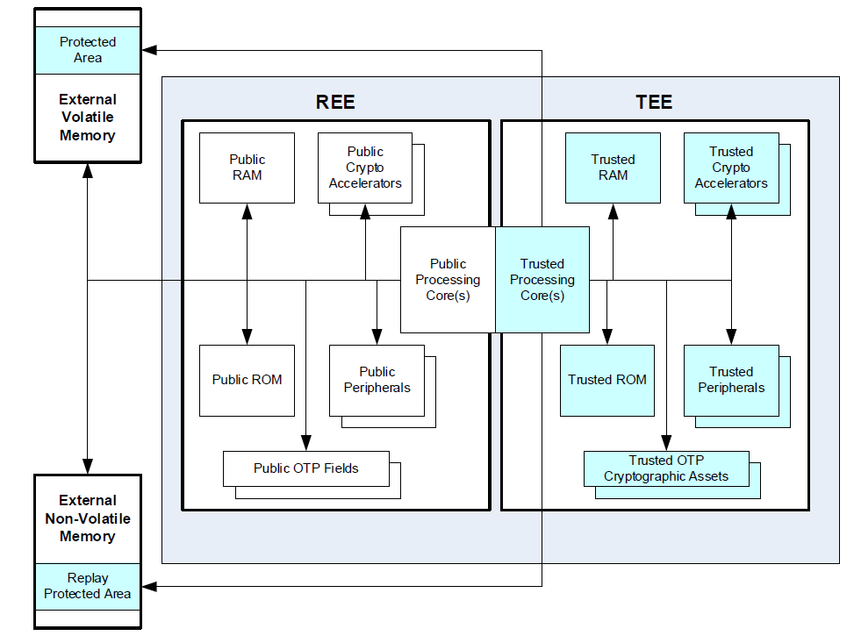
Example Hardware Details (GlobalPlatform)
Figure: Hardware Architectural View of REE and TEE,
Global Platform, TEE System Architecture v1.1

Slide 23
Example use cases for TEE apps
Payment
Only authorized code can make payments or see payment data, to protect against financial loss
IoT
Only authorized code can access physical actuator/sensor, to protect against safety issues
Confidential cloud computing
Only tenant (not cloud hoster) can access data

Slide 24
Handling policy changes at TAM
TEEP agent triggers session when new TA is needed, e.g., by app installer
TEEP agent also triggers session either:
A) at interval configured by TAM, OR
B) lazily when existing TA is started and it’s been longer than that interval

